Slide 1
Advanced Web programming
Lec-4
Types, Objects, and Namespaces
(Ref- Beginning of Asp.net 4.5 in C #- Pg no:49……)

Slide 2
A Simple Class
To create a class, you must define it by using a special block structure:
public class MyClass
{
// Class code goes here.
}
You can define as many classes as you need in the same file.

Slide 3
Building a Basic Class (Pg 49)
Construction of a .NET class piece by piece.
This class will represent a product from the catalog of an e-commerce company. The Product class will store product data, and it will include the built-in functionality needed to generate a block of HTML that displays the product on a web page.
When this class is complete, it will be able to put to work with a sample ASP.NET test page.
After you’ve defined a class, the first step is to add some basic data. The next example defines three member variables that store information about the product—namely, its name, its price, and a URL that points to an image file:
public class Product
{
private string name;
private decimal price;
private string imageUrl;
}

Slide 4
A member variable (or field) is declared as part of a class. It’s available to all the methods in the class, and it lives as long as the containing object lives.
When you create a member variable, you set its accessibility.
The accessibility determines whether other parts of your code will be able to read and alter this variable.
For example, if ClassA contains a private variable, the code in ClassB will not be able to read or modify it. Only the code in ClassA will have that ability. On the other hand, if ObjectA has a public variable, any other object in your application is free to read and alter the information it contains.
In a simple ASP.NET application, most of the variables will be private because the majority of the code will be self-contained in a single web page class.
The accessibility keywords don’t apply only to variables. They also apply to methods, properties, and events.

Slide 5
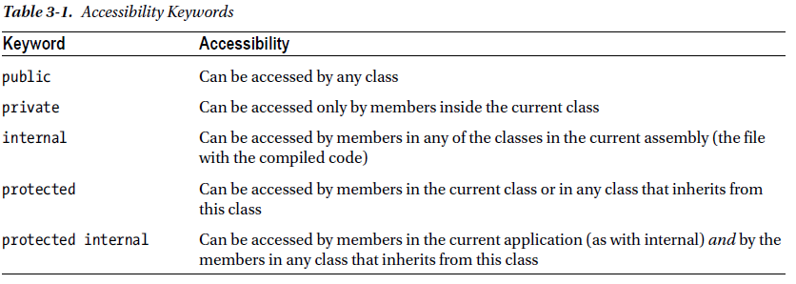

Slide 6
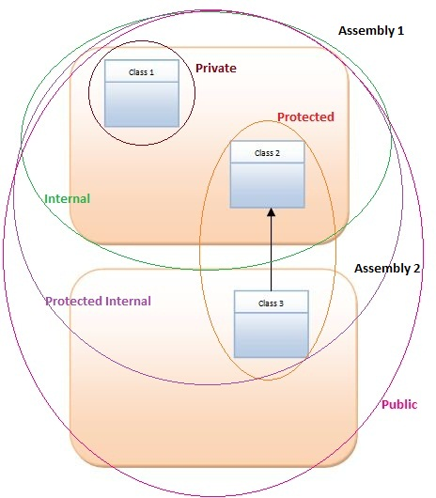

Slide 7
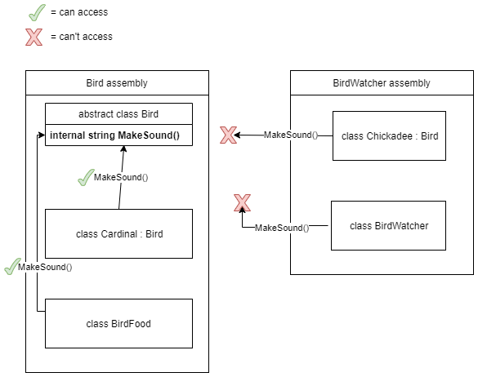

Slide 8
Creating an Object
When creating an object, you need to specify the new keyword.
The new keyword instantiates the object, which means it grabs on to a piece of memory and creates the object there.
If you declare a variable for your object but don’t use the new keyword to actually instantiate it, you’ll receive the infamous “null reference” error when you try to use your object. That’s because the object you’re attempting to use doesn’t exist, and your variable doesn’t point to anything at all.
The following code snippet creates an object based on the Product class and then releases it:
Product saleProduct = new Product();
// Optionally you could do this in two steps:
// Product saleProduct;
// saleProduct = new Product();
// Now release the object from memory.
saleProduct = null;

Slide 9
Objects are also released when your application ends.
In an ASP.NET web page, your application is given only a few seconds to live. After the web page is rendered to HTML, the application ends, and all objects are automatically released.

Slide 10
Adding Properties
The simple Product class is essentially useless because your code cannot manipulate it. All its information is private and unreachable. Other classes won’t be able to set or read this information.
To overcome this limitation, you could make the member variables public. Unfortunately, that approach could lead to problems because it would give other objects free access to change everything, even allowing them to apply invalid or inconsistent data.
A “control panel” through which your code can manipulate Product objects in a safe way. This can be done by adding property accessors.
Accessors usually have two parts. The get accessor allows your code to retrieve data from the object. The set accessor allows your code to set the object’s data.
Accessors are similar to any other type of method in that you can write as much code as you need.

Slide 11
public string Name
{
get
{
return name;
}
set
{
name = value;
}
(ref Pg no 52 from ref book pdf)

Slide 12
The client can now create and configure the object by using its properties and the familiar dot syntax. For example, if the object variable is named saleProduct, you can set the product name by using the saleProduct. Name property.
Product saleProduct = new Product();
saleProduct.Name = "Kitchen Garbage";
saleProduct.Price = 49.99M;
saleProduct.ImageUrl = "http://mysite/garbage.png";

Slide 13
Usually, property accessors come in pairs i.e, every property has both a get accessor and a set accessor. But this isn’t always the case.
You can create properties that can be read but not set (which are called read-only properties) and, less commonly, you can create properties that can be set but not retrieved (called write-only properties).
Eg of read-only property:
public decimal Price
{
get
{
return price;
}
}

Slide 14
Using Automatic Properties
To simplify more, C# language feature called automatic properties can help.
Automatic properties are properties without any code. When you use an automatic property, you declare it, but you don’t supply the code for the get and set accessors, and you don’t declare the matching private variable. Instead, the C# compiler adds these details.
Here’s a complete, condensed Product class that uses this technique:
public class Product
{
public string Name { get; set; }
public decimal Price { get; set; }
public string ImageUrl { get; set;
}
The only disadvantage is that you’ll need to switch them back to normal properties if you want to add some more specialized code when a property is set.

Slide 15
Adding a Method
It’s more common to add functionality to the classes along with the data. This functionality takes the form of methods.
Methods are simply named procedures that are built into your class. When you call a method on an object, the method does something useful, such as return some calculated data.
In the following example, we’ll add a GetHtml() method to the Product class. This method will return a string representing a formatted block of HTML based on the current data in the Product object.

Slide 16
public class Product
{
// (Additional class code omitted for clarity.)
public string GetHtml()
{
string htmlString;
htmlString = "<h1>" + Name + "</h1><br />";
htmlString += "<h3>Costs: " + Price.ToString() + "</h3><br />";
htmlString += "<img src='" + ImageUrl + "' />";
return htmlString;
}
}

Slide 17
Adding a Constructor
Ideally, classes should ensure that they are always in a valid state.
However, unless you explicitly set all the appropriate properties, the Product object won’t correspond to a valid product. This could cause an error if you try to use a method that relies on some of the data that hasn’t been supplied.
To solve this problem, you need to equip your class with one or more constructors.
A constructor is a method that automatically runs when the class is first created.
In C#, the constructor always has the same name as the name of the class. Unlike a normal method, the constructor doesn’t define any return type, not even void.

Slide 18
The next code example shows a new version of the Product class. It adds a constructor that requires the product price and name as arguments:
public class Product
{
// (Additional class code omitted for clarity.)
public Product(string name, decimal price)
{
// Set two properties in the class.
Name = name;
Price = price;
}
}

Slide 19
To create an object based on the new Product class, using its constructor:
Product saleProduct = new Product("Kitchen Garbage", 49.99M);
If you don’t create a constructor, .NET supplies a default public constructor that does nothing. If you create at least one constructor, .NET will not supply a default constructor.
// This will not be allowed, because there is
// no zero-argument constructor.
Product saleProduct = new Product();
To create an instance of a class, you need to use a constructor.
The preceding code fails because it attempts to use a zero-argument constructor, which doesn’t exist in the Product class.

Slide 20
To be continued….

